Slide 1

Attendance Processing System using Facial Recognition (SDC) MID TERM PRESENTATION
Minor Project Guide
Dr. Yadvendra Pratap Singh
(Assistant Professor)
Submitted By
Naman Kakroo
209301395
Department of Computer Science & Engineering
School of Computer Science & Engineering
Manipal University Jaipur, India
March 2023

Slide 2
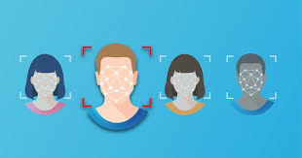
INTRODUCTION
Welcome to this presentation on our Attendance Processing System. This system is designed to provide a seamless and efficient way of managing attendance data using facial recognition technology. The traditional method of manual attendance management has been replaced by this modern system that is accurate, reliable, and time-efficient.
In this presentation, we will take a closer look at the features and benefits of our Attendance Processing System and how it can help an organization manage attendance data more efficiently.
We will also discuss the technical details of the system, including the hardware and software requirements and the system's security features.

Slide 3
Proposed model
The proposed Attendance Management System will take care of the employee attendance in any organization at any point of time. The system can keep a track of the employee’s presence, time-in and time-out. It can automatically generate reports and graphs of their availability which can be monitored by the higher authority of the respective organization.
The main objective of this project is to reduce the manual work.
The system is capable of managing employee’s presence, time-in and time-out. It can generate reports of their availability

Slide 4
REQUIREMENTS
Hardware Requirements
Software Requirements
I3 processor-based computer or higher
Memory: 3GB RAM
Hard drive
Working Web camera with clear image
Windows or Linux Operating System
Client-side Browser Support
Server-side Django + SQLITE Database Support
Communication interfaces
Communication Standard: HTTPS
Network Server: Localhost
Chrome / Mozilla Web Browser

Slide 5
System features(w screenshots)
Registration and Login Module
This module mainly deals with the functionalities related to the registration of any new employee to the organization, Log into the system and managing employee’s profile details. Using features provided by this module admin can register new employee to the system and admin / employee both can log into the system using their credentials.
Manage Attendance Details
This module mainly deals with the features related to the employee’s attendance. Using this employee can mark their presence, time-in and time-out in the system. Admin can see the availability report of each employee, employee can see his/her attendance report along with some possible filters such as filter by employee and filter by date.
Manage Employee Details
This module mainly deals with the features related to the employee’s profile. Using this admin can add a photo of the newly registered employee during registration. Admin can also command the system explicitly to train the model and system will make necessary calculation and will generate some data which will be used internally to identify each employee uniquely.

Slide 6
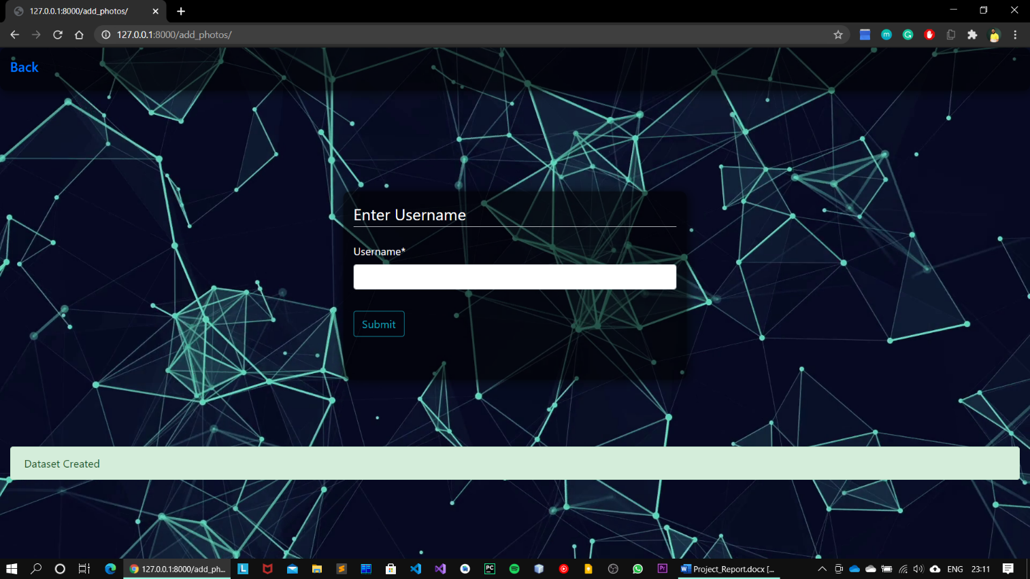
LOGIN FORM DISPLAY

Slide 7
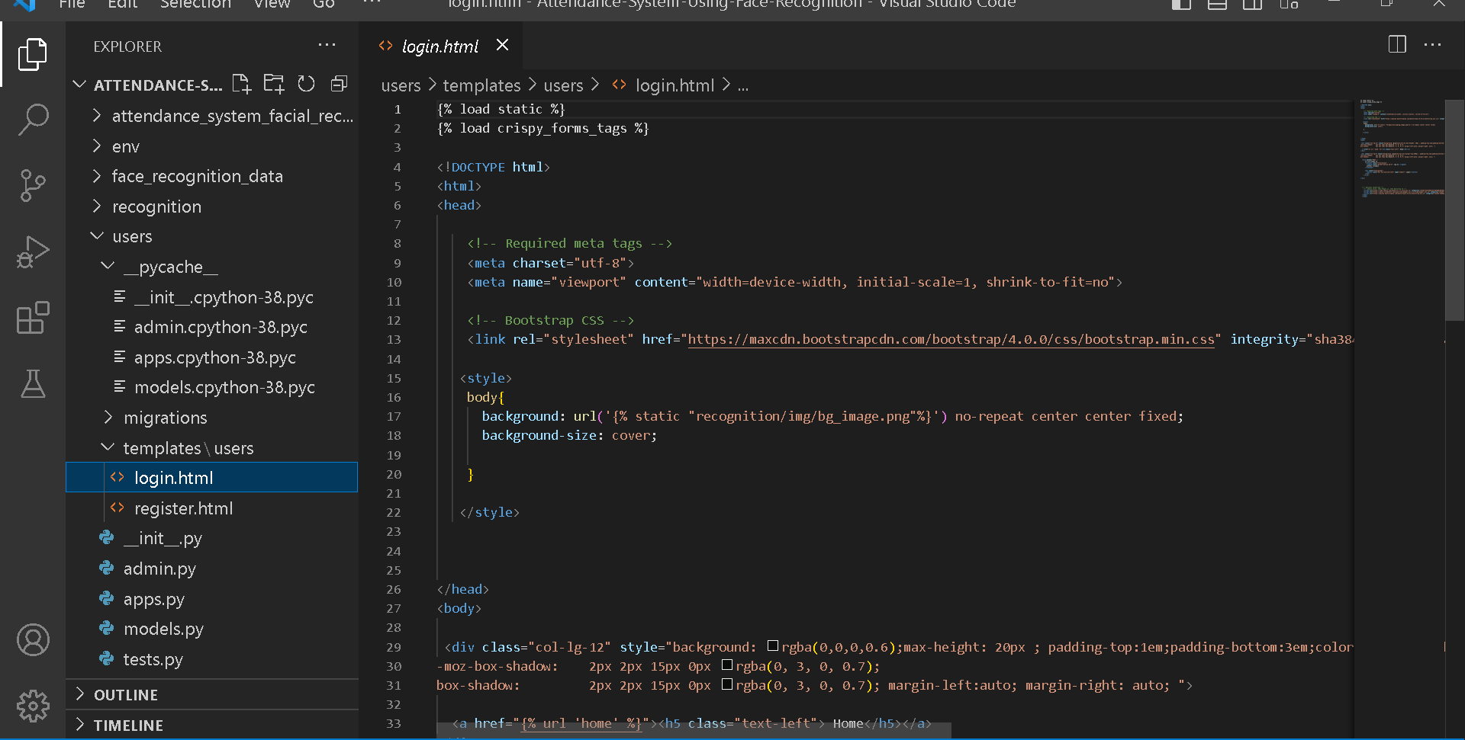
LOGIN FORM CODE(DJANGO/PYTHON)

Slide 8
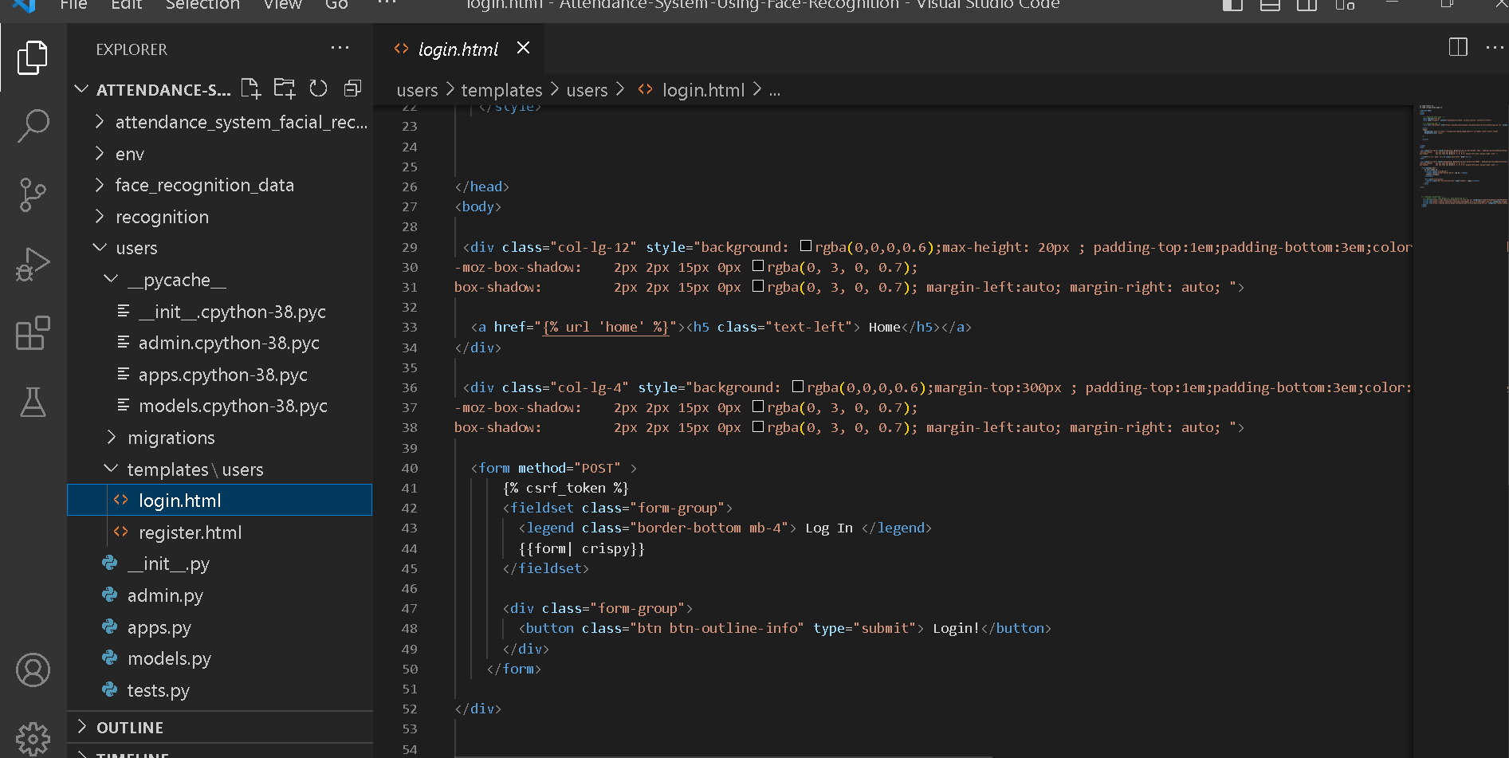

Slide 9
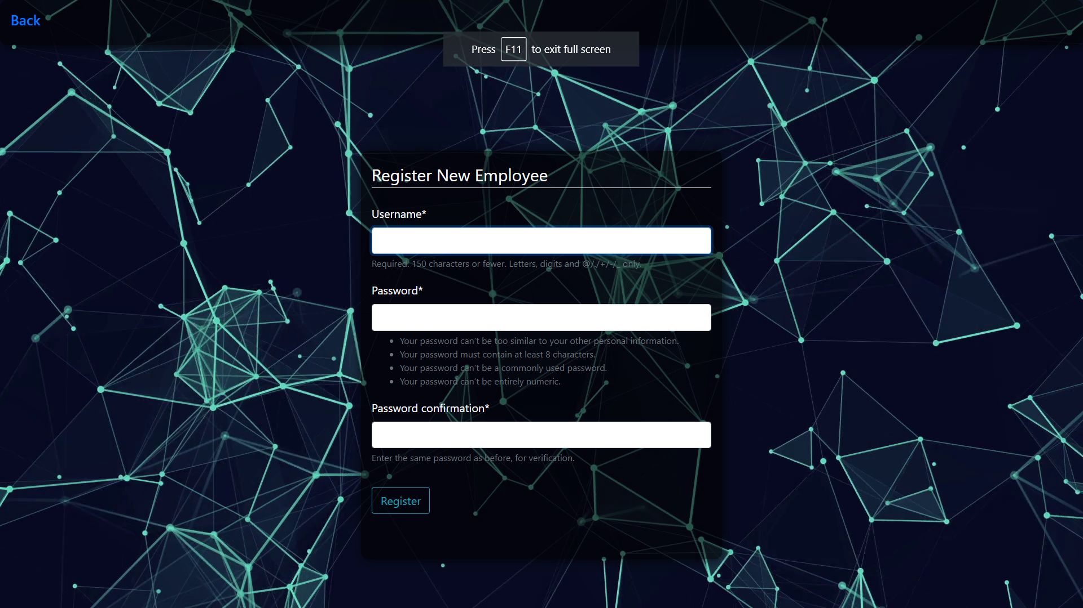
New employee registration window

Slide 10
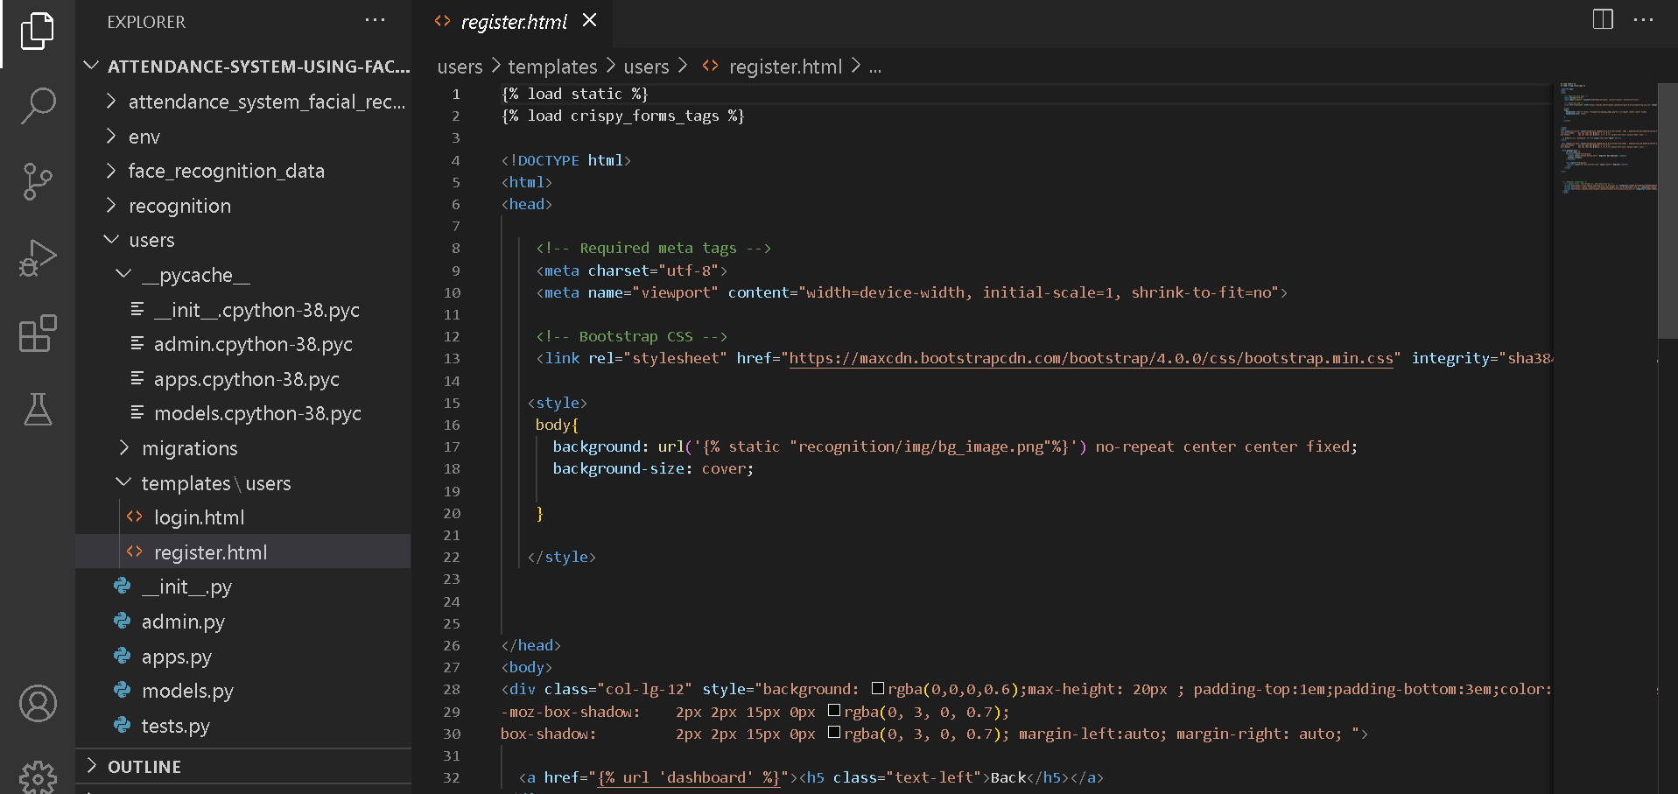
Register employee form code

Slide 11
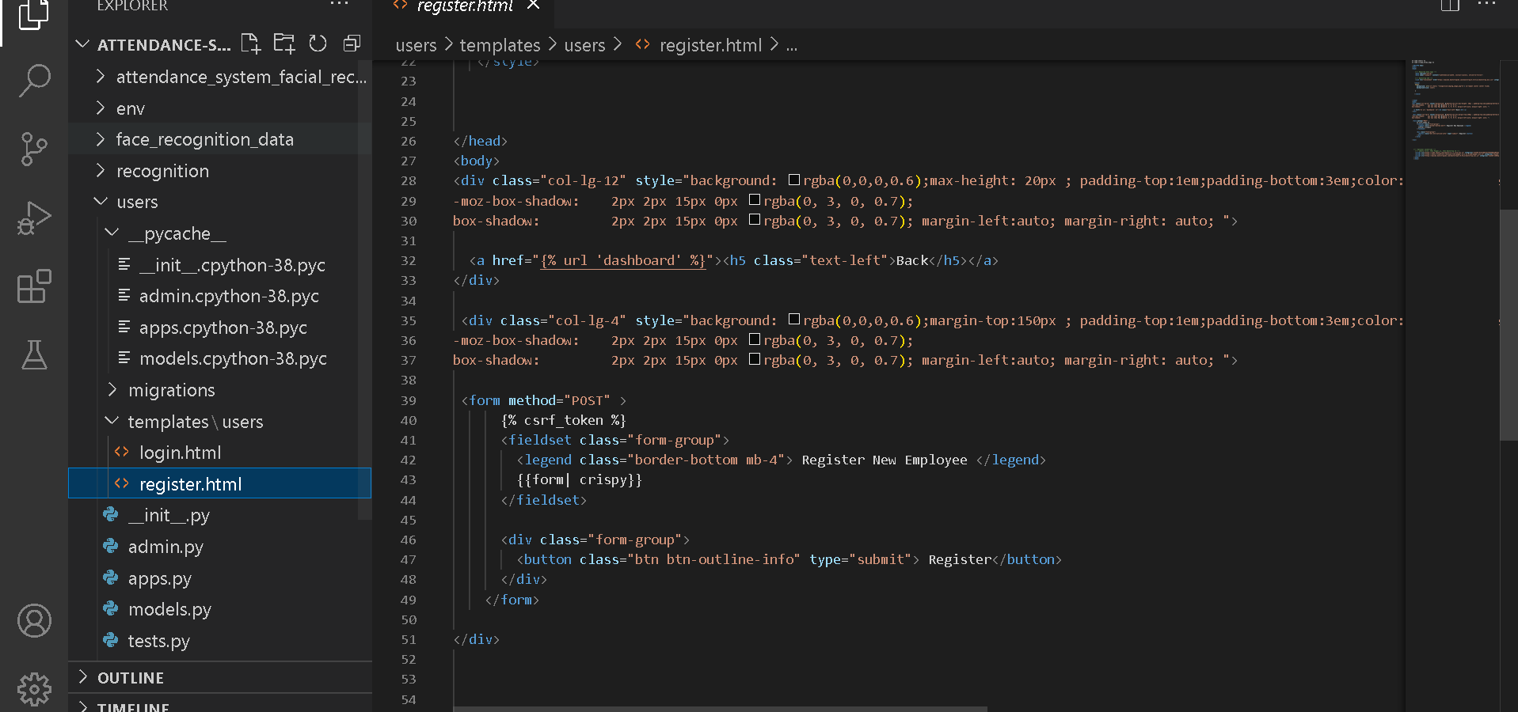
CONT.

Slide 12
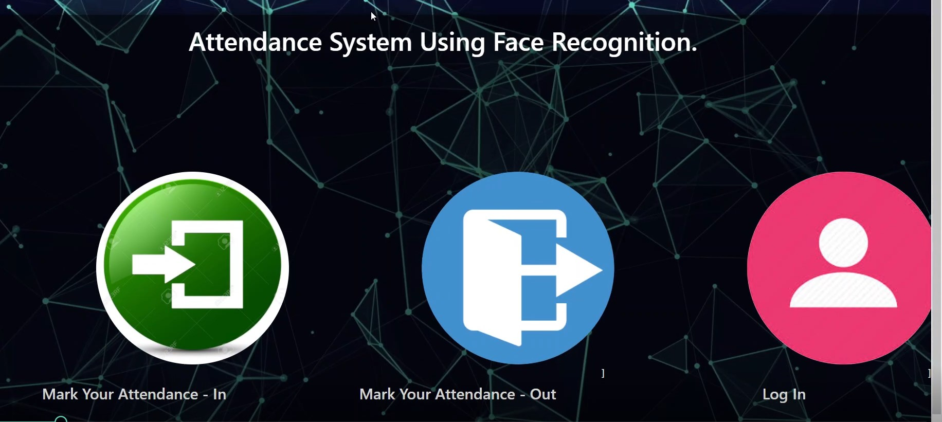
ATTENDANCE MARKING PAGE

Slide 13
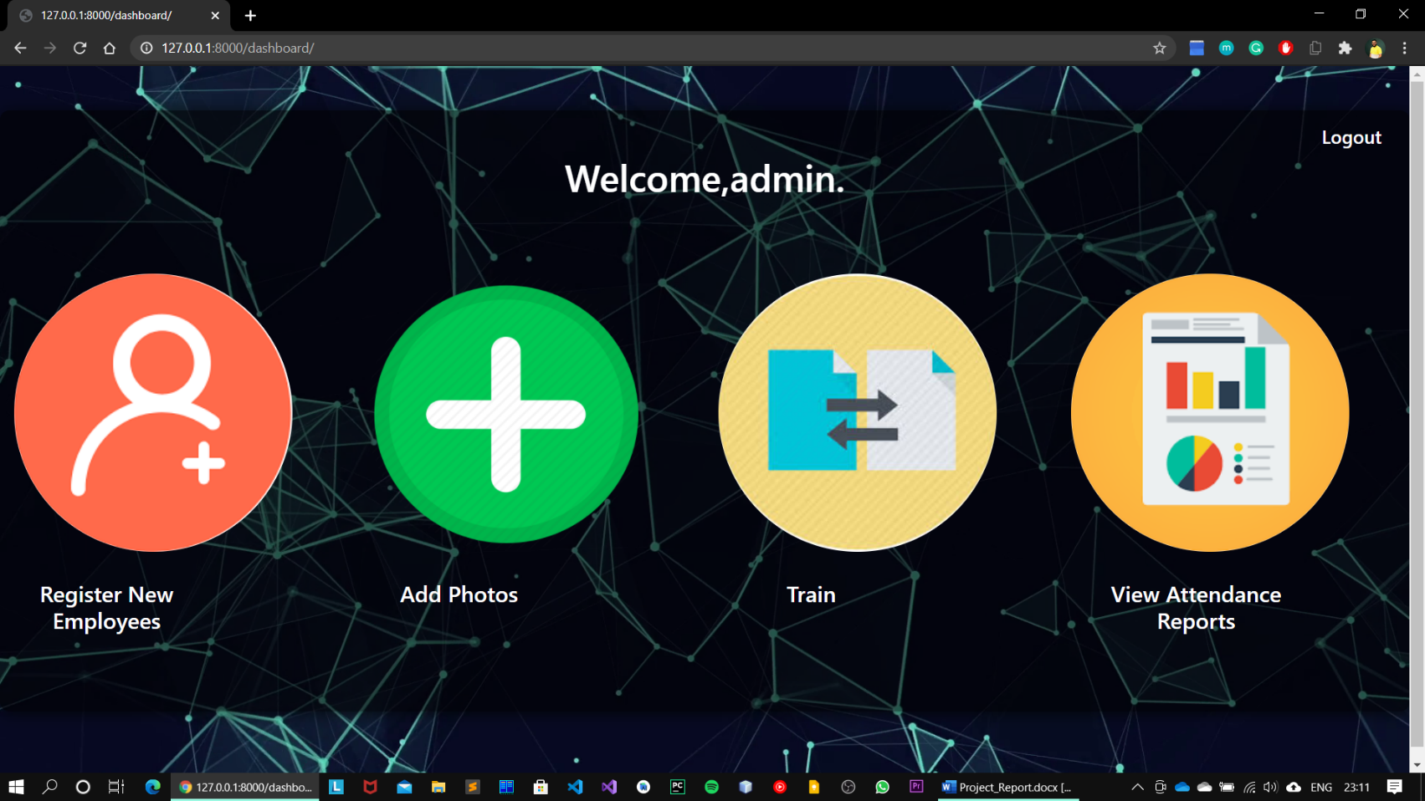
MAIN PAGE

Slide 14
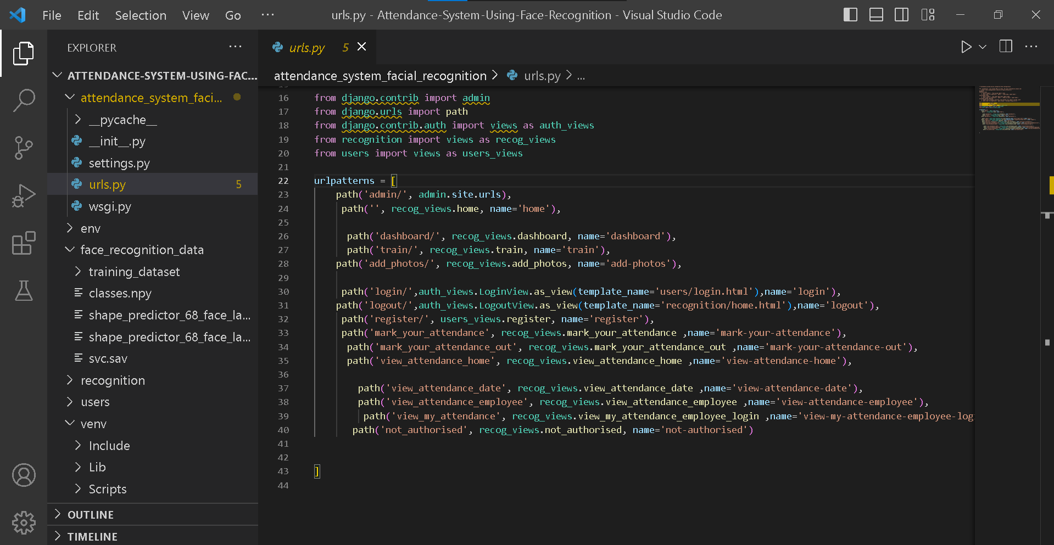
URL routing for the web application

Slide 15
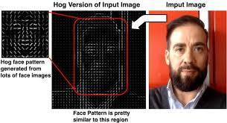
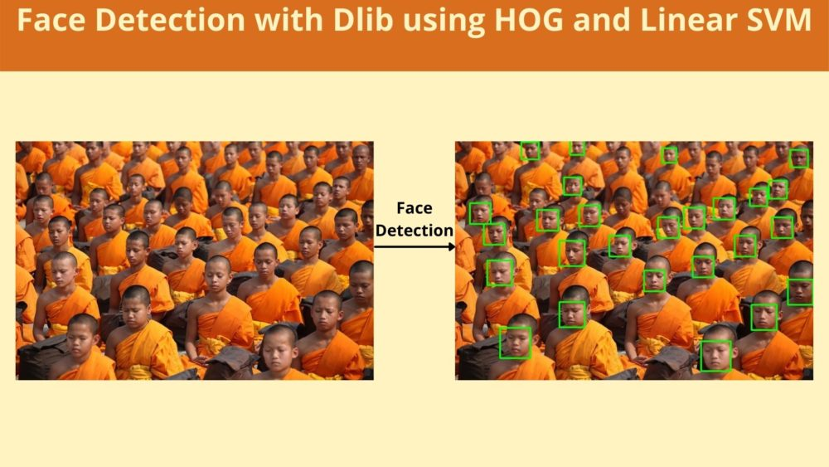
Working of facial recognition (w.i.p)
FACE DETECTION : Dlib’s HOG facial detector
Facial Landmark Detection: Dlib's 68 point shape predictor

Slide 16
CONCLUSION
review highlights the potential benefits of using facial recognition technology in attendance management systems. The use of facial recognition technology can significantly improve the accuracy and efficiency of attendance management while reducing the time and effort required for attendance management. The studies reviewed in this literature review demonstrate the successful implementation of facial recognition technology in attendance management systems across various industries. The results of these studies provide evidence for the effectiveness of facial recognition technology in attendance management systems.

Slide 17
REFERENCES
CSS & Bootstrap:
https://getbootstrap.com/
For debugging:
https://stackoverflow.com/
Singh, G., Srivastava, R., & Mishra, N. (2019). Automatic attendance management using facial recognition. International Journal of Innovative Technology and Exploring Engineering, 8(12), 145-150.
adopted from the IEEE Guide to Software Requirements Specifications (Std 830-1993).

Slide 18
Thank you
Queries!!!

